Slide 1
DC Motor Locker Opener
Yohaan Anthraper

Slide 2
What is it?
The Locker Opener is a DC Motor controlled by a raspberry pi and powered by an external power source in order to open a door at a user’s command/will.
It is 1 of 3 locker devices that in tandem with each other, will create a Automatic Locker System.
The other two devices, being Stanley Go’s Display and Jeremy Rende’s automatic Lock.

Slide 3
Materials Necessary
DC Motor ($14)
Raspberry Pi ($100)
Metal Rod (Same diameter as motor tip) (Free - $10)
Transistor Driver Board ($6)
Wires (Jumper Cables/Power cables/Alligator Clips) (Approx $10-$15)
12v Power Supply ($10 - $40)
Magnets (Free - $20)

Slide 4




Where to get them?
A-1 Electronics
Creatron
Scrapyard
Amazon

Slide 5
Schedule...
Configure Connection
Attach Metal Rod to Motor
Program Code
Connect Magnets
Shorten wires and make product commercializable
<Number 4 can be done earlier in the process if you wish>

Slide 6
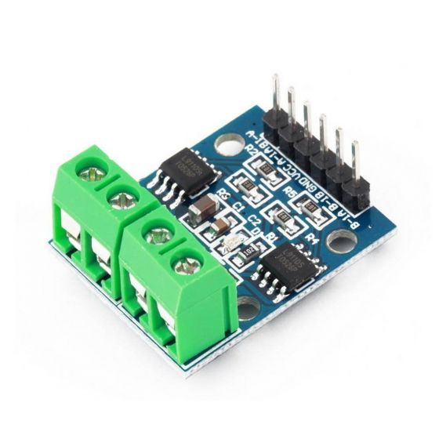
How to...
First, Connect the correct inputs and outputs to and from the Transistor Driver Board
L9110S H-Bridge
2.5-12V at 800mA
Up to two motors

Slide 7
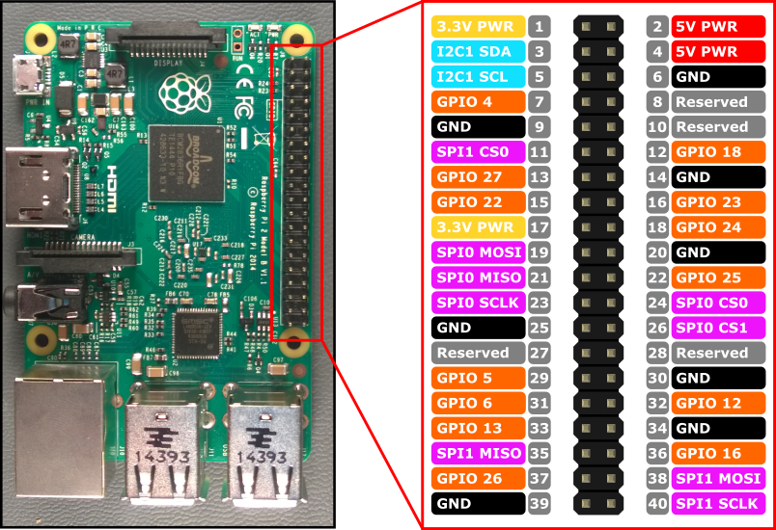
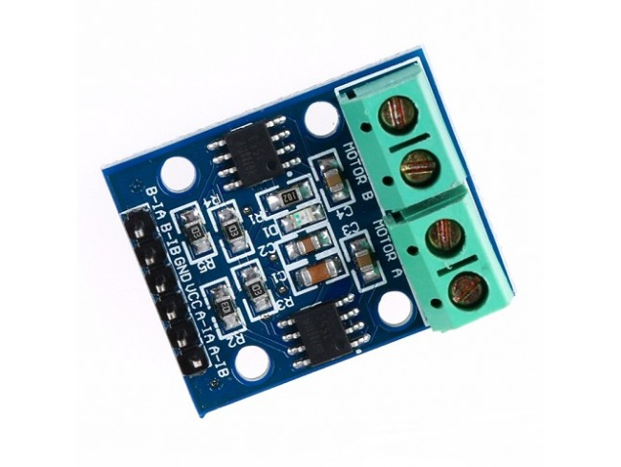
How to… Continued...
Next, connect the transistor driver board to the Raspberry Pi

Slide 8

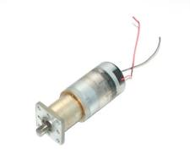
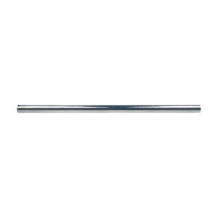
How to… Continued...
Finally, attach L shaped Rod to the end of the motor
(Layer Plumbing Heat shrink for Added Adhesiveness)

Slide 9
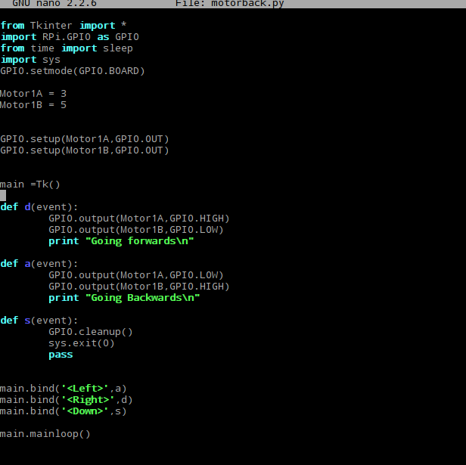
P
R
O
G
R
A
M
M
I
N
G

Slide 10
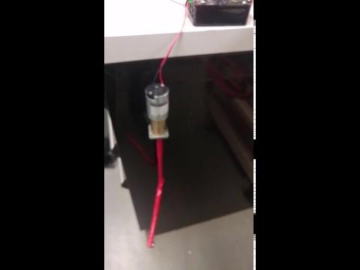
Final Application .

Slide 11
Thankyou. -TECH 101 -TECH 153

